Slide 1
Group-9 Diabetes Prediction System
Aditya Vadrevu - 11601517
Suhas Siddarajgari Tellatakula – 11626111
Srikar Reddy Gunna - 11594012
Sai Praneeth Reddy Avula - 11582402 Indu Shashi Guda - 11618418
.

Slide 2
Contents
Project Goal
Context Diagram
Component Diagram
Used ML Description
UI Screenshots
Sequence Diagram
UI <-> ML
Next Steps

Slide 3
Goal
The goal of a "Diabetes Prediction System" is to develop a tool or model that can accurately predict the risk or likelihood of an individual developing diabetes in the future. This prediction is typically based on various risk factors and health information associated with the individual, such as age, gender, family history, body mass index (BMI), blood pressure, cholesterol levels, and lifestyle factors like diet and physical activity.
The main objectives of a Diabetes Predictor are:
Early Detection: To identify individuals who are at a higher risk of developing diabetes, even before they exhibit noticeable symptoms. Early detection allows for proactive interventions and lifestyle changes to prevent or manage the condition effectively.
Personalized Risk Assessment: To provide personalized risk assessments based on an individual's specific health and lifestyle information, as diabetes risk factors can vary from person to person.

Slide 4
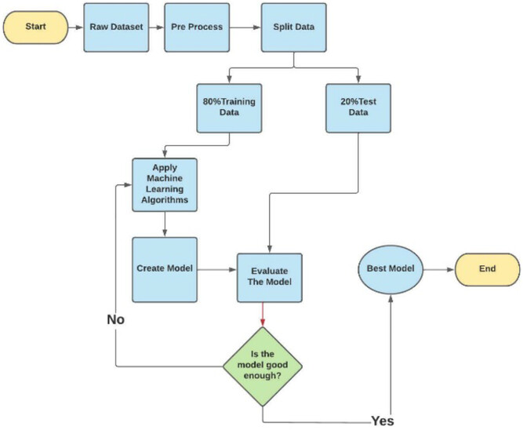
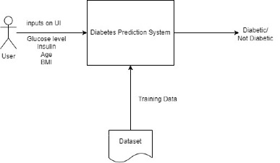
Context Diagram

Slide 5
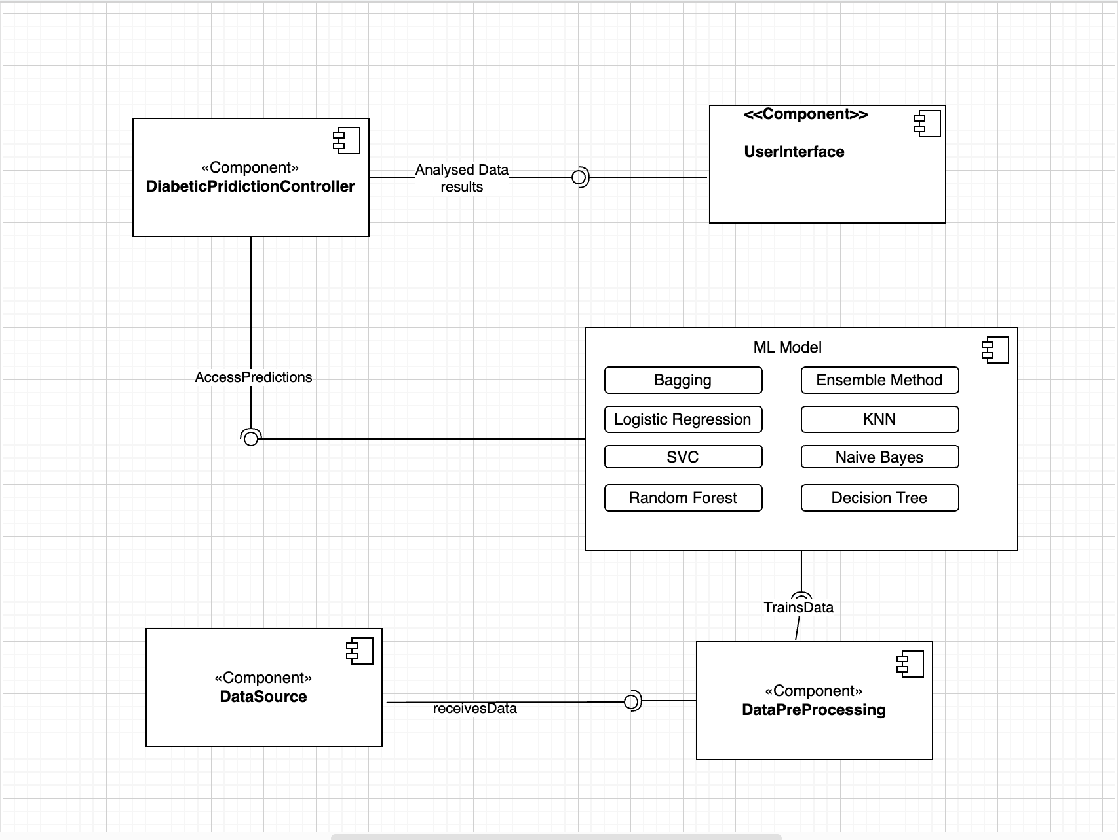
Component Diagram

Slide 6
Description of the used machine learning - I
Code Location: https://github.com/Aditya-Mankar/Diabetes-Prediction
Our machine learning model employs supervised type learning where the algorithm learns from labeled data to make predictions or classifications, as mentioned below:
Bagging
Logistic Regression
SVC
Random Forest
Decision Tree
Naive Bayes
Ensemble Method

Slide 7
Description of the used machine learning - II
Used Dataset The dataset used in this system is the Pima Indians dataset from the UCI Machine learning repository: https://github.com/Aditya-Mankar/Diabetes-prediction/blob/master/diabetes.csv
This dataset consists of various featuring columns like Pregnancies, Glucose, Blood Pressure, Skin Thickness, Insulin, BMI (Body Mass Index), Diabetes Pedigree Function, Age and finally the Outcome.

Slide 8
Description of the used machine learning - III
The implementation of a bagging model has been done in the context of diabetes prediction as it works by training multiple instances of a base model on different subsets of the training data and combining their predictions to make a final, more robust prediction.
When predicting diabetes, employing the bagging method entails training several models, which could include decision trees or alternative classifiers, on distinct subsets of the accessible patient data.
Subsequently, these individual predictions are combined to generate a more dependable diabetes risk or diagnosis prediction. This approach serves to alleviate overfitting and enhance the predictive model's accuracy.
We have introduced cross-validation, Hyperparameter Tuning to check the performance of the model.

Slide 9
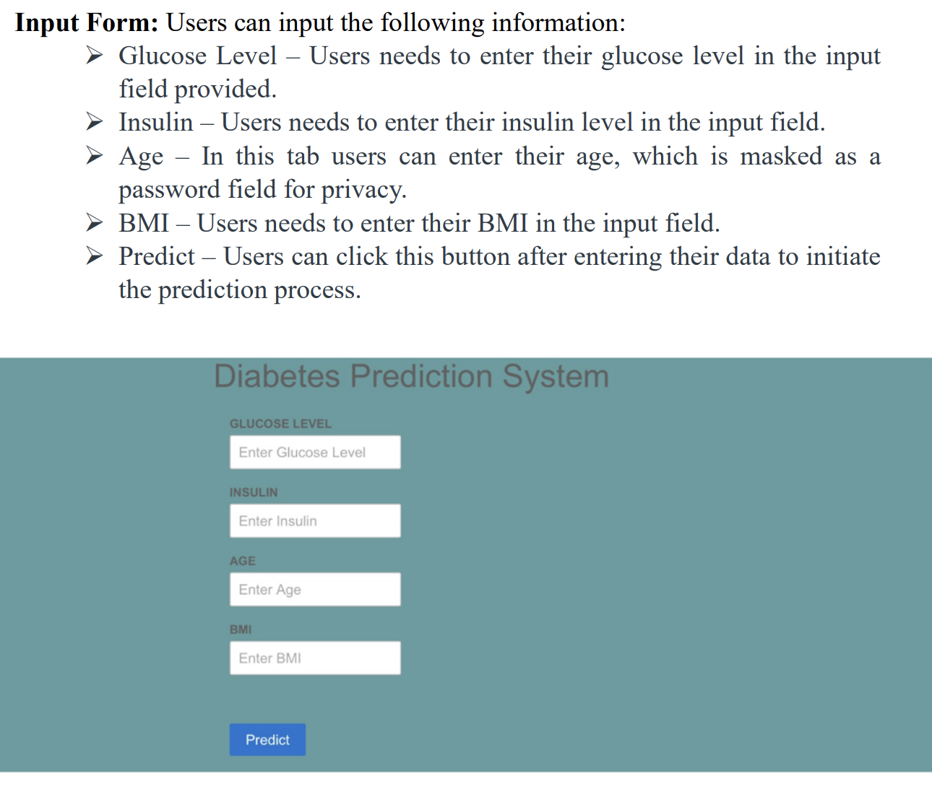
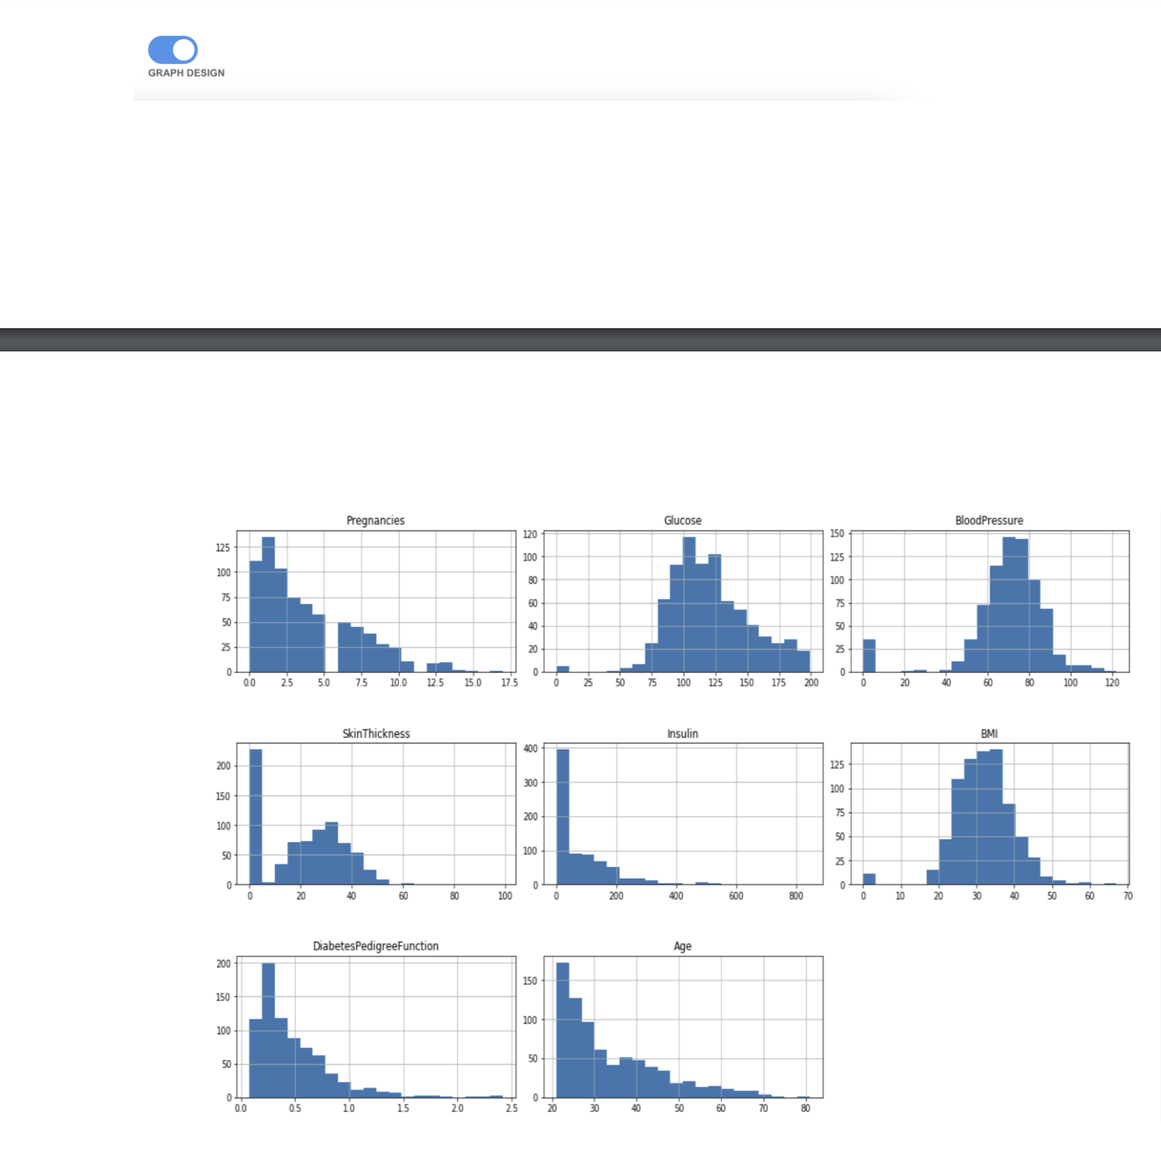
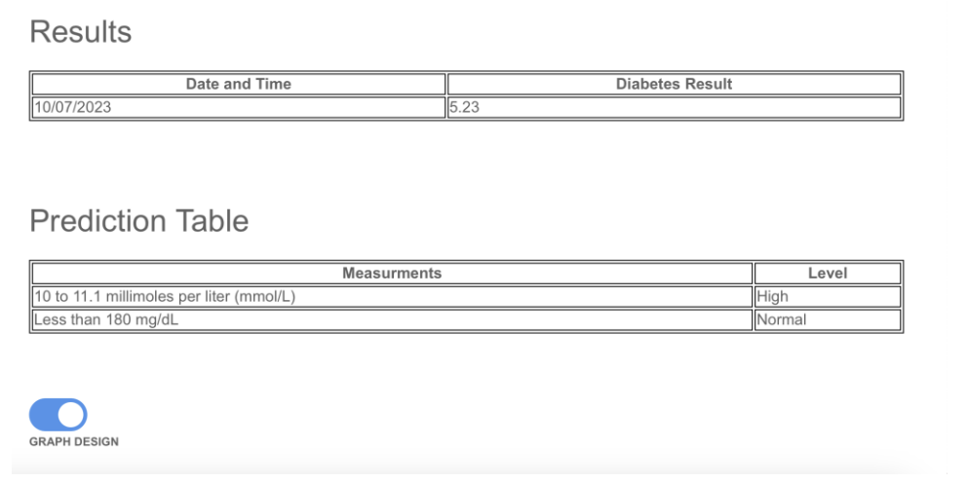
User Interface
To enhance the current user interface, we plan to add features such as displaying analytics for the diabetes data used in the tool's training, providing users with information and tips about diabetes, and presenting a range of prediction outcomes to indicate the risk level (high or normal) of the situation.

Slide 10
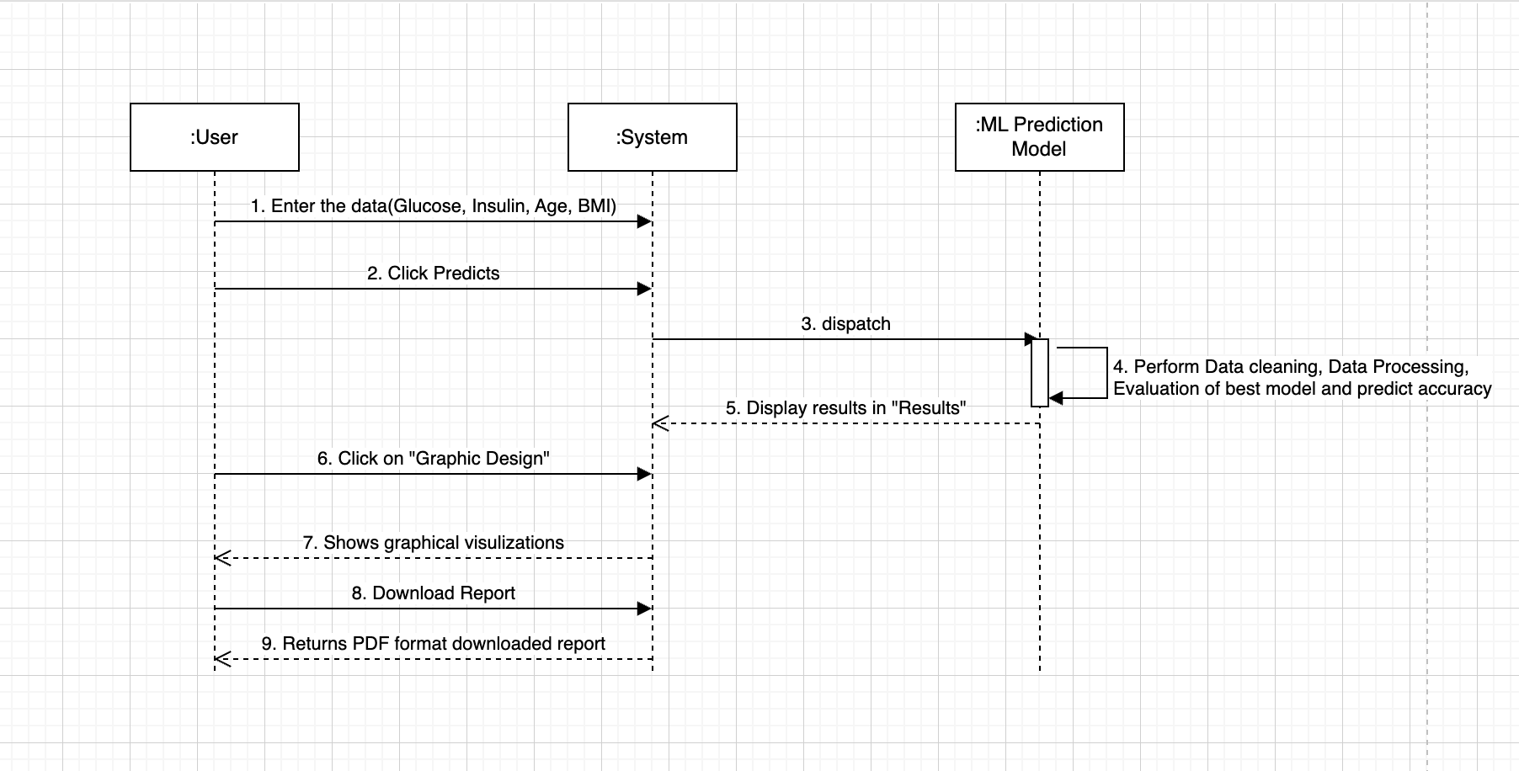
User Interface – Sequence diagram

Slide 11
User Interface <–> Identification Path linking UI to implemented ML
The path linking the user interface to the implemented machine learning (ML) model involves several steps in the system's workflow. Here's an identification of the key steps and components in this path:
User Interface (UI):
The user starts by interacting with the UI, where they enter data such as Glucose level, Insulin level, Age, and BMI into input fields.
User Input Processing:
The UI collects and processes the user's input data.
Clicking "Predict":
After entering the data, the user clicks the "Predict" button in the UI.
System Logic:
The UI communicates with the underlying system logic or controller. This controller coordinates the flow of data and actions within the system.
Machine Learning Model:
The system logic directs the user's input data to the implemented machine learning model. The ML model is responsible for making predictions about diabetes levels based on the input features (Glucose, Insulin, Age, BMI).
Prediction Calculation:
The ML model processes the input data, performs calculations, and produces a prediction based on the model's learned patterns and algorithms.
Results Generation:
The prediction result generated by the ML model is passed back to the system logic.
Storing Results (Optional):
The system logic may store the prediction results in a database for future reference.
Displaying Results:
The system logic instructs the UI to display the prediction results in the "Results" section of the user interface.
User Interaction (Optional):
The user can interact with the displayed results on the UI, such as reviewing the predicted diabetes level.
Graphical Visualization (Optional):
If the user clicks on the "Graph Design" switch, the UI may show graphical visualizations. This may involve further interactions between the UI and the system logic to generate and display the visualizations.
This path involves communication between the user interface, the system logic, and the machine learning model. The machine learning model plays a central role in processing the input data and generating predictions, while the UI serves as the user's gateway to provide input and receive the results. Optionally, the system may store the results in a database and offer additional functionality, such as graphical visualizations, to enhance the user's experience.

Slide 12
Next Steps
No | Task | Status
1. | Code Analysis | Completed
2. | Implementation of new Models(Bagging, Ensemble methods) | Bagging Classifier implementation – Completed Ensemble Methods – In Progress (ETA: 11/20)
3. | Implementation of Cross-Validation code with hyper parameter tuning | Completed
4. | Development of UI | Working on the statistical image marshaling and unmarshalling between UI and Backend. ETA: 11/25
5. | Integration testing for UI and Backend | ETA: 11/28
6. | Deployment of Project | ETA: 11/29

Slide 13
Thank You

